Slide 1
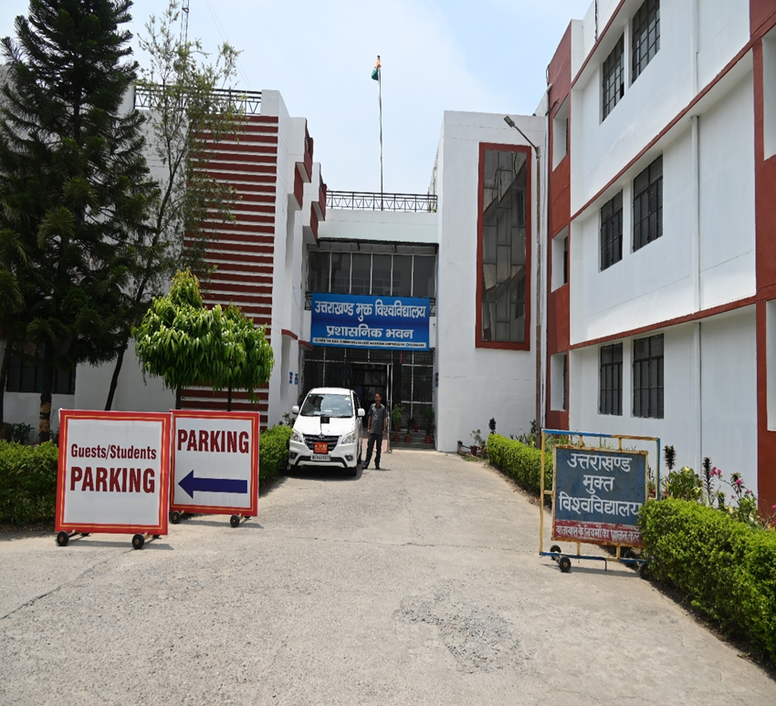
Presentation to Expert Committee for Inclusion of Uttarakhand Open University Under Section 12-B of UGC Act, 1956

Slide 2
Name of the University with Notification No. & Date of State Govt.
Name of the University: Uttarakhand Open University
Details of Act:
Established by the Act, 2005 (Act No. 23 of 2005) of Uttaranchal Govt.
Notification No.
Notification No. No.608/ Vidhayee and Sansadiya Karya/2005

Slide 3
About University
The headquarter of the University was created at Haldwani. The University has established 08 Regional Centres and 126 Learner Support Centres across the state of Uttarakhand. As it has jurisdiction over the whole state of Uttarakhand.
The University offers 80+ programmes with on roll enrolment of more than 99,000+ learners.
UOU has been recognized under section 2 (f) of the UGC Act, 1956 by University Grants Commission (UGC)
All the programmes of the university are approved by the Distance Education Bureau (DEB), University Grants Commission (UGC).
University, is accredited with B++ Grade (with 2.77 CGPA on 4 Point Scale) by National Assessment Accreditation Council (NAAC) in October 2022 in its very first cycle.
In the year 2021, University has been awarded with National Award for the Empowerment of Persons with Disabilities (Divyangjan) by the Hon’ble President of India in recognition of its outstanding performance as Punravas Peshewaron ke Vikas mein Salangn Sarvshrestha Sanagathan.

Slide 4
About University
Area of land registered and its location in the state
Headquarters: Haldwani , 25 Acres
Dehradun Campus: 1.220 Hectare
As per the University Grants Commission (Fitness of Open Universities for Grants)(Amendment)Rules 2022,Gazettee Notification published on dated 19.05.2022 the required land is
“(i) Developed Land 5 Acres”

Slide 5
UOU in Numbers
ODL
Programmes
43
Online Courses Through SWAYAM
05+02
Regional Centres
08
Learner Support Centres
130
School of Studies
14
Learners
99000+
Teachers & Academicians
157
Non-teaching
Staff
190
Departments
34
Counsellors
1900 +

Slide 6
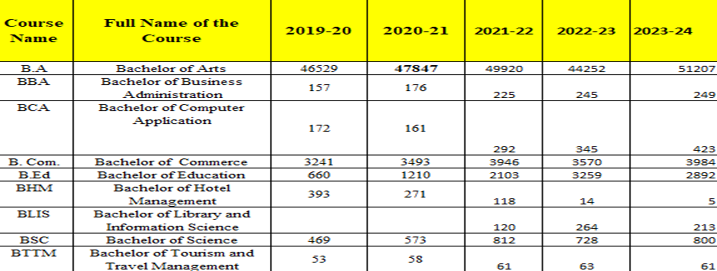
Courses and the Number of Students Admitted in Each Course During the Last Three Years
Bachelor Degree Programmes

Slide 7
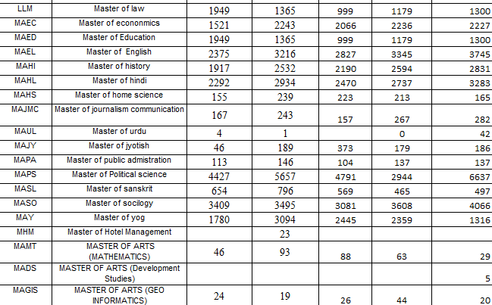
Courses and the Number of Students Admitted in Each Course During the Last Three Years
Post Graduate Degree Programmes

Slide 8
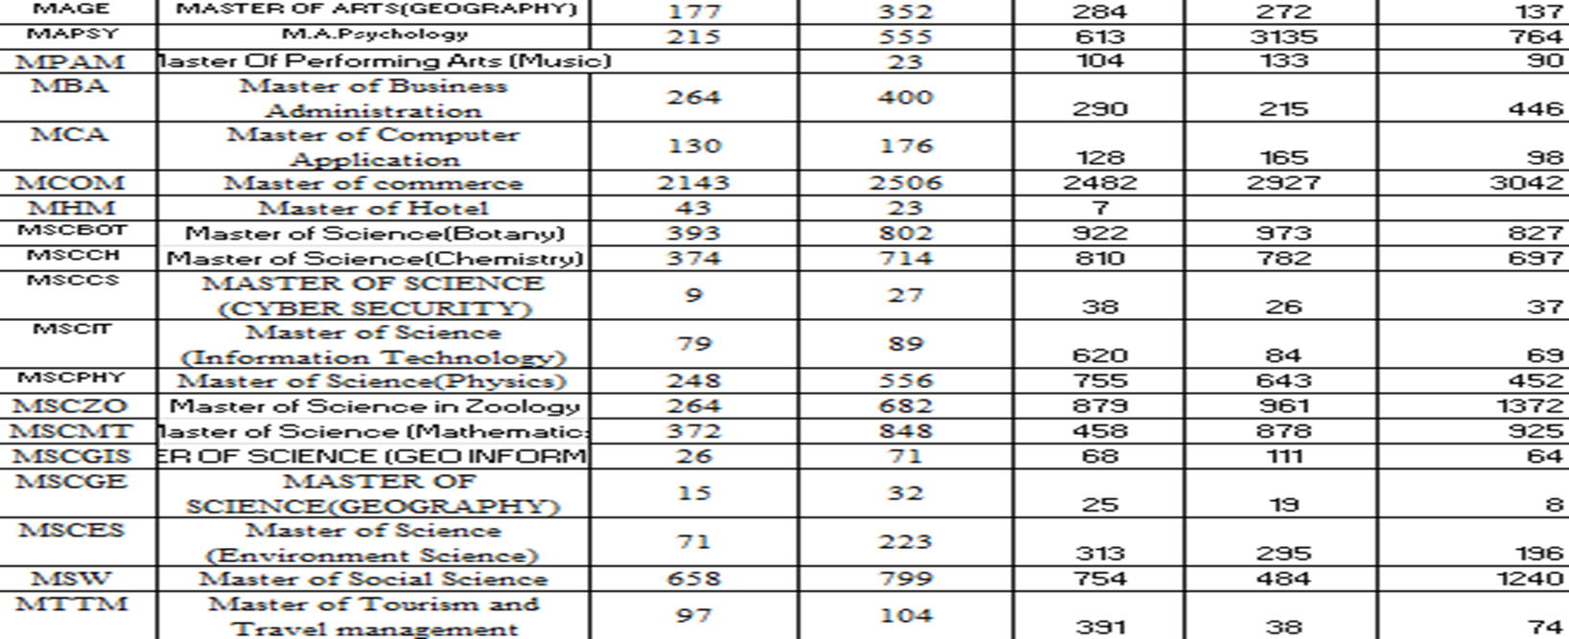
Courses and the Number of Students Admitted in Each Course During the Last Three Years
Post Graduate Degree Programmes

Slide 9
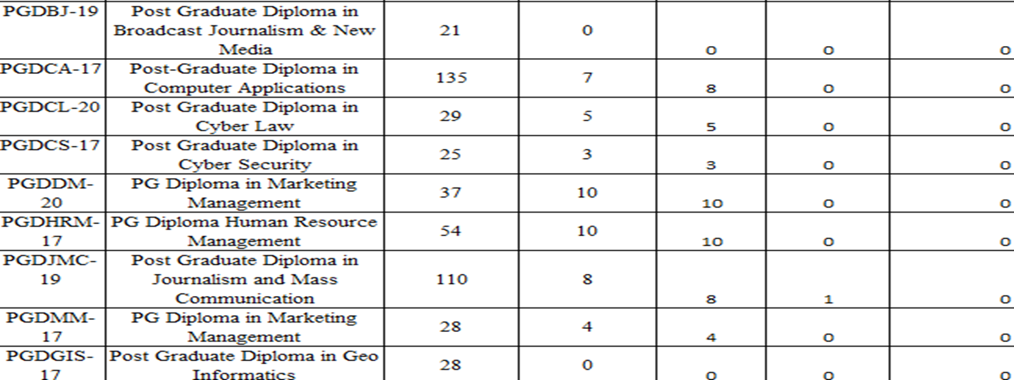
Courses and the Number of Students Admitted in Each Course During the Last Three Years
Advance Diploma Programmes

Slide 10
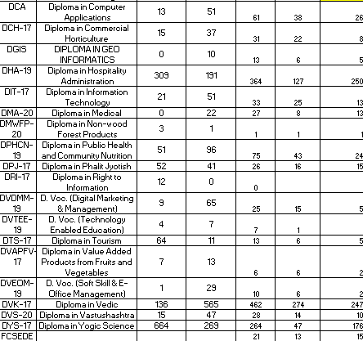
Courses and the Number of Students Admitted in Each Course During the Last Three Years
Diploma Programmes

Slide 11
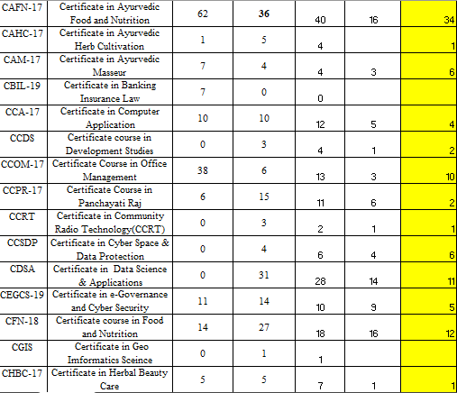
Courses and the Number of Students Admitted in Each Course During the Last Three Years
Certificate Programmes

Slide 12
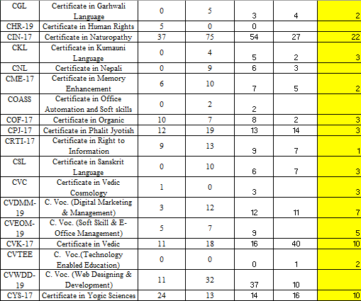
Courses and the Number of Students Admitted in Each Course During the Last Three Years
Certificate Programmes

Slide 13
Courses and the Number of Students Admitted in Ph. D (Regular Mode)

Slide 14
Whether Functioning of the University have been Computerized?
S. No. | Areas of e governance | Area | Web-link of relevant-website/document
1 | University Website | The main purpose of the University website is to provide the information related to admission, examination results, recruitments, and day-to-day activities of the University with its all stakeholders and especially the learners. | www.uou.ac.in
 | Finance and Accounts | Accounting Tally | Tally ERP
2 | E-Learning Platform | This portal provide free access to the online courses offered by the University. The portal is developed on the MOODLE platform. | elearning.uou.ac.in
3 | Students’ Grievance System | The learner can generate the support ticket which is attended by the concerned department/person to resolve the problem. | http://support.uou.ac.in/tickets.php
4 | Student One View | The learner can track the SLM, progress in the semester/year. | http://apps.uou.ac.in/
5 | Attendance Management System | Management of Biometric Attendance records | Biometric Attendance of the Employees
6 | Recruitment | This portal is developed for online recruitment. | https://career.uou.ac.in/

Slide 15
Whether Functioning of the University have been Computerized?
S. No. | Areas of e governance | Area | Web-link of relevant-website/document
7 | Online Admission | This portal is developed to facilitate online admission process. The payment gateway is integrated with the website for online fee payment. | https://online.uou.ac.in/
8 | Online Degree Application | The student can apply for the degree via online mode through this utility. | https://online.uou.ac.in/econvocation/UoUECONFormAll.aspx
9 | Change of Student Center | The Learner can change his/her study center using this utility. | https://online.uou.ac.in/Student_SC_Change.aspx
10 | Change of Personal Details | The Learner can change his/her personal information which are incorrectly entered in the admission form using this utility. | https://online.uou.ac.in/SA_DataChange.aspx
11 | MPDD | This module is for the issue of the books to the learners/Study Centers/Regional Centers, etc. | https://www.uou.ac.in/mpdd
12 | Store Management | Management and issue of material through store via online indent. | Ics.uou.edu

Slide 16
Whether Functioning of the University have been Computerized?
S. No. | Areas of e governance | Area | Web-link of relevant-website/document
13 | University Intranet website | Important forms, holiday list, faculty details, etc are present in the Intranet website. | Intranet.uou.ac.in
14 | Student Information System | It is use for Admission/re-registration(by challan) ,book Distribution ,Exam marks entry Results processing ,tabulation Generation ,Admit card Generation ,marks-sheet generation, trans-script generation, Study Center Payment calculation, | http://admdesk.uou.ac.in/(S(gq5ea1r13n2lqc45w3rge52f))/Default.aspx
15 | Online exam form entry | Fill exam form (Back and improvement) | https://online.uou.ac.in/UoUStudentExamApplicationTermCondition.aspx
16 | Online Results/marks Sheet download | Here students can check/Download online marks-sheet | http://results.uou.ac.in/
17 | Departmental Blog | Blogs which are development and maintained by the department provide online support facility to the learners. | blogsomcuou.wordpress.com http://uoucomputerscience.blogspot.com/ http://historyuou.blogspot.com/ http://geographyuou.blogspot.com/ http://englishuou.blogspot.com/ http://chemistryuou.blogspot.com/ http://educationuou.blogspot.com/ http://zoologyuou.blogspot.com/ http://botanyuou.blogspot.com/ http://lawuou.blogspot.com/ http://vocationalstudiesuou.blogspot.com/ http://agricultureuou.blogspot.com/

Slide 17
Registered Office of the University
Uttarakhand Open University
Behind Transport Nagar, Vishwavidyalaya Marg,
Haldwani (Nainital) 263139 Uttarakhand
Toll Free : 1800 180 4025, 7037515087 (10 AM to 5 PM) | (Mon to Sat) Operator : 05946-286000
Name & Headquarters of the Society/Promoting Agency: Not Applicable
Details of the university/institution promoted by the Society/Agency
Ministry of Education, Government of Uttarakhand

Slide 18
Details of the Governing Council, Academic Council, Finance Committee, BOS etc.
Executive Council: https://uou.ac.in/executive-council
Academic Council: https://uou.ac.in/academic-council
Planning Board: https://uou.ac.in/planning-board-0
Finance Committee: https://www.uou.ac.in/fc-minutes
CIQA: https://www.uou.ac.in/ciqa
Board of Studies: https://www.uou.ac.in/bos-minutes
Examination Committee: https://www.uou.ac.in/mom-exam
Admission Committee: https://www.uou.ac.in/mom-admission

Slide 19
Details of Vice Chancellor, Registrar, Financial Officer and Administrative Officers
Vice Chancellor: Prof. Om Prakash Singh Negi
University Ombudsman: Prof. N. S. Bhandari
Registrar: Sh. K R Bhatt
Finance Officer: Sh. Surya Pratap Singh
Administrative Officers:
Mr. Vimal Kumar Mishra, Deputy Registrar, General Administration
Mr. Vikrant Kumar, Assistant Registrar, Establishment and Research & Innovation
Mr. Bhupender Nayal, Assistant Registrar. Maintenance and Purchase
Mrs. Ratti Dogra, Assistant Registrar, CIQA and RSD
Mr. Abhishek Bajpai, Assistant Registrar, Finance
Mr. Deepak Kumar, Assistant Registrar, Admission and Exam.

Slide 20
Source of Finance and Quantum of Funds Available
As on Financial Year : 2023-24
Fees: Rs. 47,16, 24, 801/-
State Govt.: Rs.42,09,75,275/-
UGC-DEB/MHRD.: Rs. 1,00,00,000/-

Slide 21
List of Research Publications for the last 3 years
https://uou.ac.in/downloads/12b/Research-and-Innovation/Research%20Publications/

Slide 22
List of Ongoing Research Projects with their Source of Funding

Slide 23
List of Ongoing Research Projects with their Source of Funding

Slide 24
Future Plans for Starting New Courses
University is planning to start new courses based on latest trends in information technology including skill based and job-oriented courses (Vocational and NCVET) to fulfil the local aspirations. The list of the courses is as follows:
P G Courses in Indian Knowledge System
Master in Human Rights
Courses in Women Studies
Priest Training Based Courses
Solar Technology Based Courses
Customer Support Operations based Courses
Home Stay Operation Based Courses
Courses Based on GST and Tally Accounting
Educational Technology Based Courses
Entrepreneurship Skills and Digital Marketing Strategies
Web Technology

Slide 25
Courses Offered in the Emerging Areas
Master of Science-Cyber Security
Master of Science Information Technology
Master of Computer Applications
Master of Geo-informatics
Master of Yoga
Master of Tourism and Travel Management
Master of Business Administration
Master Journalism and Mass Communication
Bachelor of Science
Bachelor of Computer Applications
Bachelor of Tourism and Travel Management

Slide 26
Details of Courses Run in ODL Mode
Under Graduate Programmes:
BACHELOR OF ARTS- BA
BACHELOR OF SCIENCE – B.Sc
BACHELOR OF BUSUNESS ADMINISTRATION – BBA
BACHELOR OF COMMERCE- B.Com.
BACHELOR OF COMPUTER APPLICATIONS -BCA
BACHELOR OF TOURISM AND TRAVEL MANAGEMENT - BTTM
BACHELOR OF SPECIAL EDUCATION- (Intellectual Development Disability) - B.Ed. spl. Ed.
BACHELOR OF SPECIAL EDUCATION- (Learning Disability) - B.Ed. spl
BACHELOR OF SPECIAL EDUCATION- (Visual Impairment) - B.Ed. spl. Ed.
BACHELOR OF SPECIAL EDUCATION- (Hearing Impairment) - B.Ed. spl. Ed.
BACHELOR OF EDUCATION - B.Ed.
BACHELOR OF LIBRARY & INFORMATION SCIENCE- BLIS-21

Slide 27
Details of Courses Run in ODL Mode
Post Graduate Programmes:
1. MASTER OF ARTS (ECONOMICS) - MA (ECONOMICS)
2. MASTER OF ARTS (HISTORY) - MA (HISTORY)
3. MASTER OF ARTS (POLITICAL SCIENCE) - MA (POLITICAL SCIENCE)
4. MASTER OF ARTS (PUBLIC ADMINISTRATION) -MA (PUBLIC ADMINISTRATION)
5. MASTER OF ARTS (SOCIOLOGY) –MA (SOCIOLOGY)
6. MASTER OF SOCIAL WORK - MSW
7. MASTER OF ARTS (PSYCHOLOGY) - MA (PSYCHOLOGY)
8. MASTER OF ARTS (DEVELOPMENT STUDIES
9. MASTER OF ARTS (HINDI) - MA (HINDI)
10. MASTER OF ARTS (ENGLISH) – MA (ENGLISH)
11. MASTER OF ARTS (SANSKRIT) -MA (SANSKRIT)
12. MASTER OF ARTS (JYOTISH) – MA (JYOTISH)
13. MASTER OF PERFORMING ARTS (MUSIC) – MPA (MUSIC)
14. MASTER OF ARTS (URDU
15. MASTER OF COMMERCE – M. Com.

Slide 28
Details of Courses Run in ODL Mode
16. MASTER OF BUSINESS ADMINISTRATION- M.B.A.
17. MASTER OF SCIENCE (INFORMATION TECHNOLOGY) – M.Sc(INFORMATION TECHNOLOGY) 1
18. MASTER OF SCIENCE (CYBER SECURITY) - M.Sc. (CYBER SECURITY)
19. MASTER OF COMPUTER APLICATIONS
20. MASTER OF ARTS (HOME SCIENCE)–MA (HOME SCIENCE) School of Education
21. MASTER OF ARTS (EDUCATION) – MA (Education)
22. MASTER OF ARTS (JOURNALISM AND MASS COMMUNICATION) – MA (JOURNALISM AND MASS COMMUNICATION)
23. MASTER OF ARTS (GEOGRAPHY) - M.A. (GEOGRAPHY)
24. MASTER OF SCIENCE (ENVIRONMENTAL SCIENCE) - M.Sc (ENVIRONMENTAL SCIENCE)
25. MASTER OF ARTS (ENVIRONMENTAL STUDIES) - M.A (ENVIRONMENTAL STUDIES)
26. MASTER OF SCIENCE (BOTANY) - M.Sc. (BOTANY)
27. MASTER OF SCIENCE (CHEMISTRY) - M.Sc (CHEMISTRY)
28. MASTER OF SCIENCE (PHYSICS) - M.Sc. (PHYSICS)
29. MASTER OF SCIENCE (ZOOLOGY) - M.Sc (ZOOLOGY)
30. MASTER OF SCIENCE (MATHEMATICS) - M.Sc (MATHEMATICS)

Slide 29
Details of Courses Run in ODL Mode
Diploma Programmes:
1. Diploma in Non-wood Forest Products (DNWFP-21)
2. Diploma In Geo Informatics (DGIS-21)
3. Diploma in Public Health and Community Nutrition (DPHCN-21)
4. Diploma in Yogic Science (DYS-21)
5. Diploma in Phalit Jyotish (DPJ-21)
6. Diploma in Vedic Karmakand (DVK-21)
7. Diploma in VastuShastra (DVS-21)
8. Diploma in Medical Astrology (DMA-21)
9- Diploma in Information Technology (DIT-21)
10. Diploma in Computer Applications (DCA-21)
11. Diploma in Tourism Studies (DTS-21)
12. Diploma in Hospitality Administration (DHA-21)
13. Diploma in Commercial Horticulture (DCH-21)
14. Diploma in Value Added Products from Fruits and Vegetables ((DVAPFV-21)

Slide 30
Details of Courses Run in ODL Mode
Certificate Courses
1. Certificate Course in Panchayati Raj (CCPR-17)
2. Certificate in Memory Enhancement (CME-17)
3. Certificate in Vedic Karmkand (CVK-17)
4. Certificate in Phalit Jyotish (CPJ-17)
5. Certificate in Sanskrit Language (CSL-17)
6. Certificate in Vedic Cosmology (CVC-20)
7. Certificate in Garhwali Language (CGL-21)
8. Certificate in Nepali Language (CNL-21)
9. Certificate in Kumaoni Language (CKL-21)
10. Certificate Course in Office Management (CCOM-17)
11. Certificate in e-Governance and Cyber Security (CEGCS-17)
12. Certificate in Computer Application CCA-22
13. Certificate in Ayurvedic Masseur (CAM-17)
14. Certificate in Herbal Beauty Care (CHBC-17)
15. Certificate in Ayurvedic Herb Cultivation (CAHC-17)

Slide 31
Details of Courses Run in ODL Mode
16. Certificate in Ayurvedic Food and Nutrition (CAFN-17)
17. Certificate in Yogic Sciences (CYS-17)
18. Certificate in Naturopathy (CIN-17)
19. Certificate course in Food and Nutrition (CFN-18)
20. Certificate in Right to Information (CRTI-21)
21. Certificate in Cyber Space & Data Protection (CCSDP-21)
22. Foundation Course in special education (FC-SEDE)
23. Certificate in Non-wood Forest Products (CNWFP-20)
24. Certificate in Geo Informatics (CGIS-21)
25. C. Voc. (Digital Marketing & Management)- (CVDMM-23)
26. C. Voc. (Soft Skill & E- Office Management)- (CVEOM-23)
27. C. Voc. (Technology Enabled Education)- (CVTEE-23)
28. Certificate in Community Radio Technology (CCRT-23)
29. Certificate in Data Science & Applications (CDSA-23)
30. Certificate course in Development Studies (CCDS-21)
31. Certificate in Organic Farming (COF-17)

Slide 32
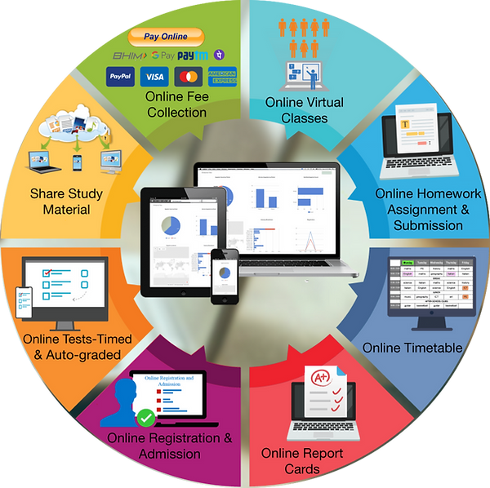
Details of New Educational and Communication Technologies Being Used
Digitized SLMs
https://uou.ac.in/programmes

Slide 33
Linkages with other Institutions (National & International, give details)
Linkages with other Institutions
https://uou.ac.in/downloads/12b/MOUs/All%20MOUs%20UOU.pdf

Slide 34
Linkages with other Institutions (National & International, give details)

Slide 35
Admission Procedure (Online Admission and Related Activities)
Registration
Filling Application Form
Confirmation of Admission
Confirmation email to learners with details of admission
Generation of Barcode based I-card
Payment of fees through Payment Gateway
Documents to be uploaded
Verification of Application
Submission of Application
100% Online Admission Process including Payment of Fees

Slide 36
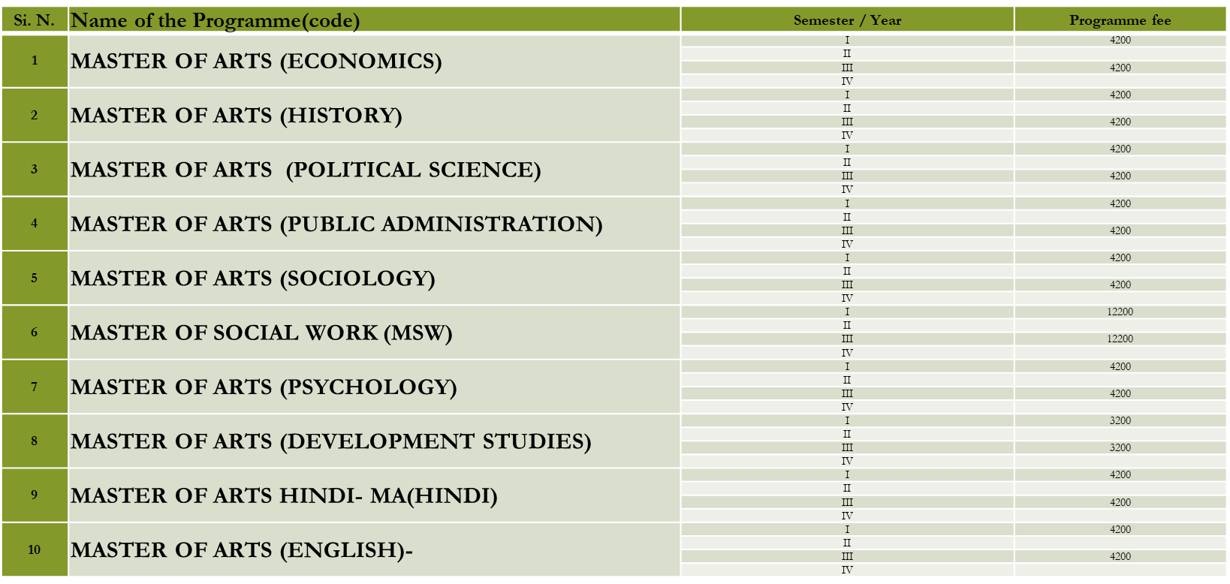
Fee Structure for the Different Courses Run by the University
Master Degree Programmes

Slide 37
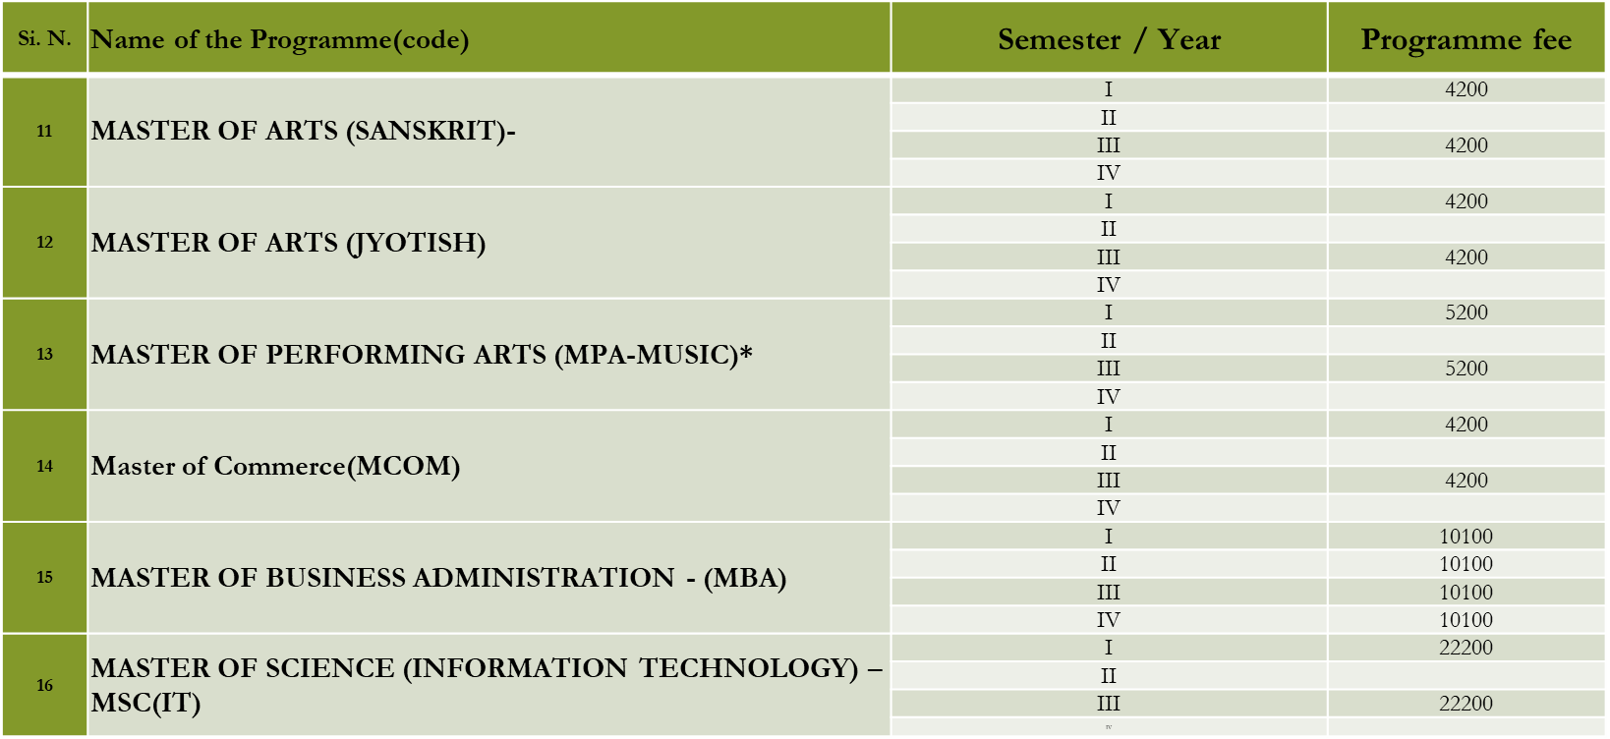
Fee Structure for the Different Courses Run by the University
Master Degree Programmes

Slide 38
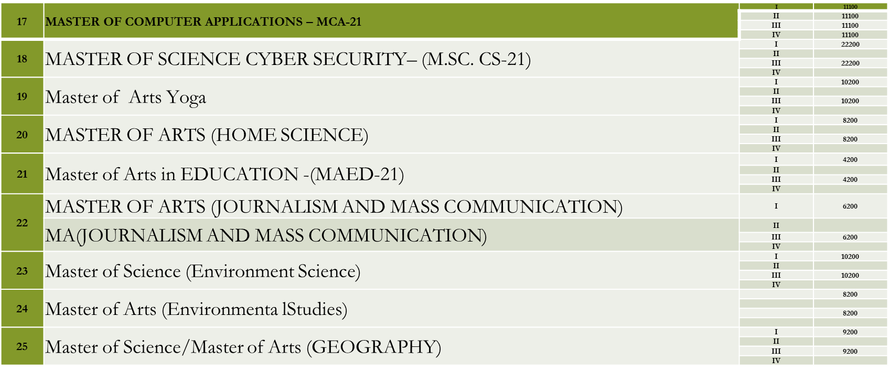
Fee Structure for the Different Courses Run by the University
Master Degree Programmes

Slide 39
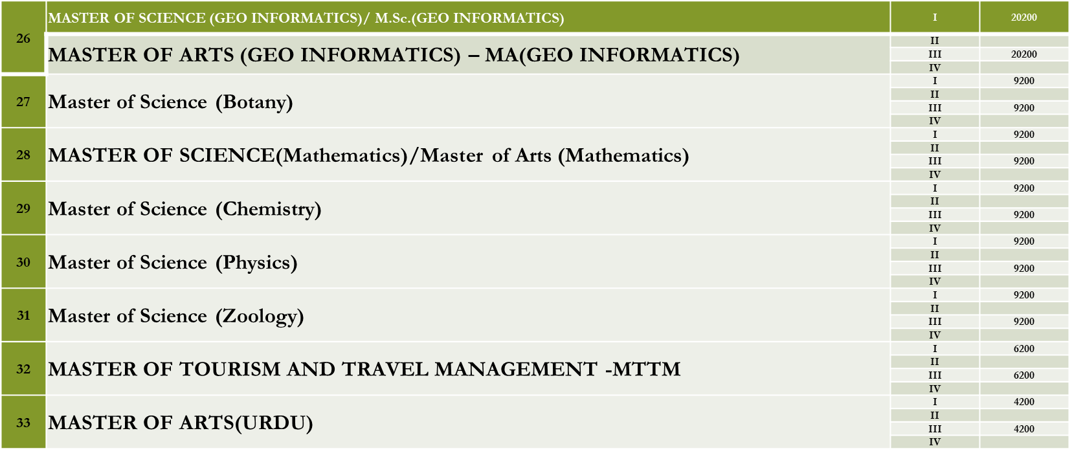
Fee Structure for the Different Courses Run by the University
Master Degree Programmes

Slide 40
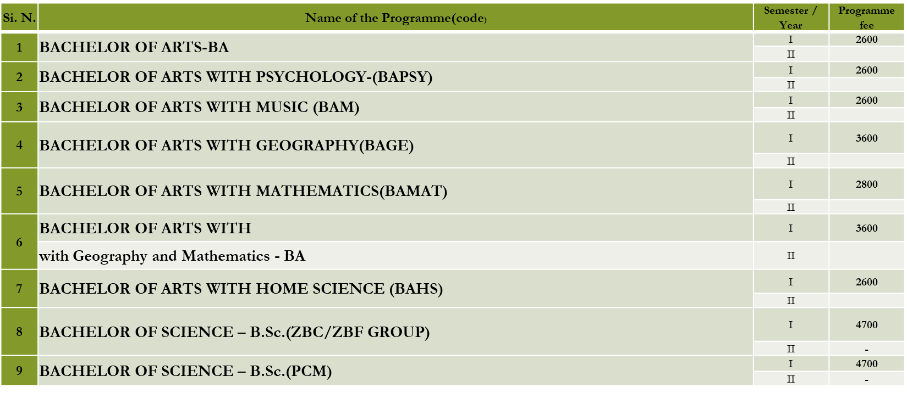
Fee Structure for the Different Courses Run by the University
Bachelor Degree Programmes

Slide 41
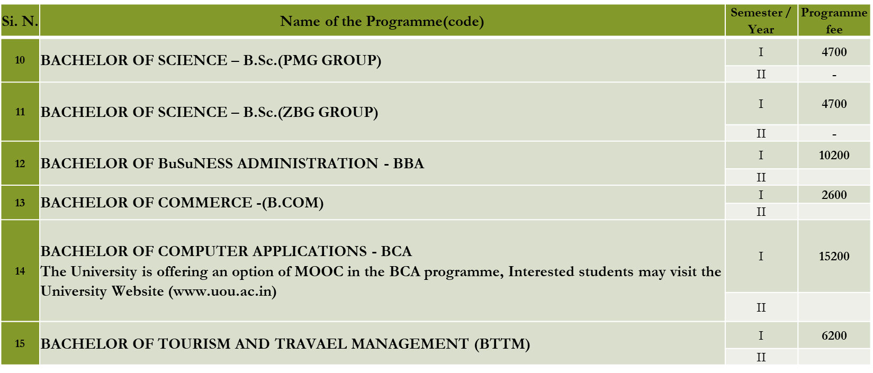
Fee Structure for the Different Courses Run by the University
Bachelor Degree Programmes

Slide 42
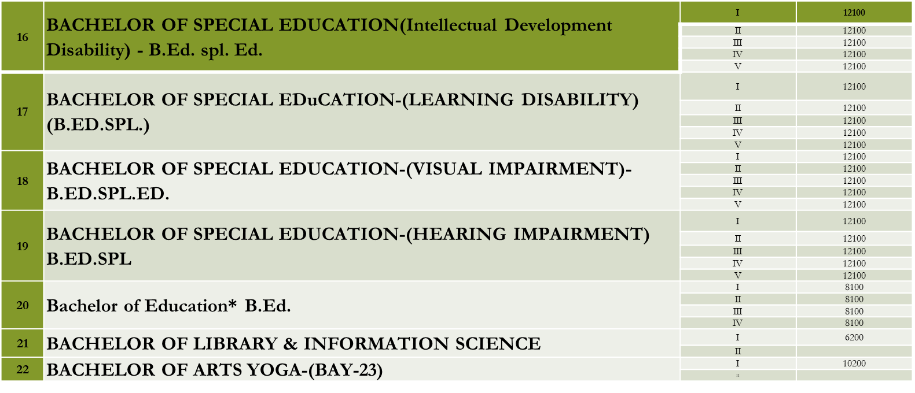
Fee Structure for the Different Courses Run by the University
Bachelor Degree Programmes

Slide 43
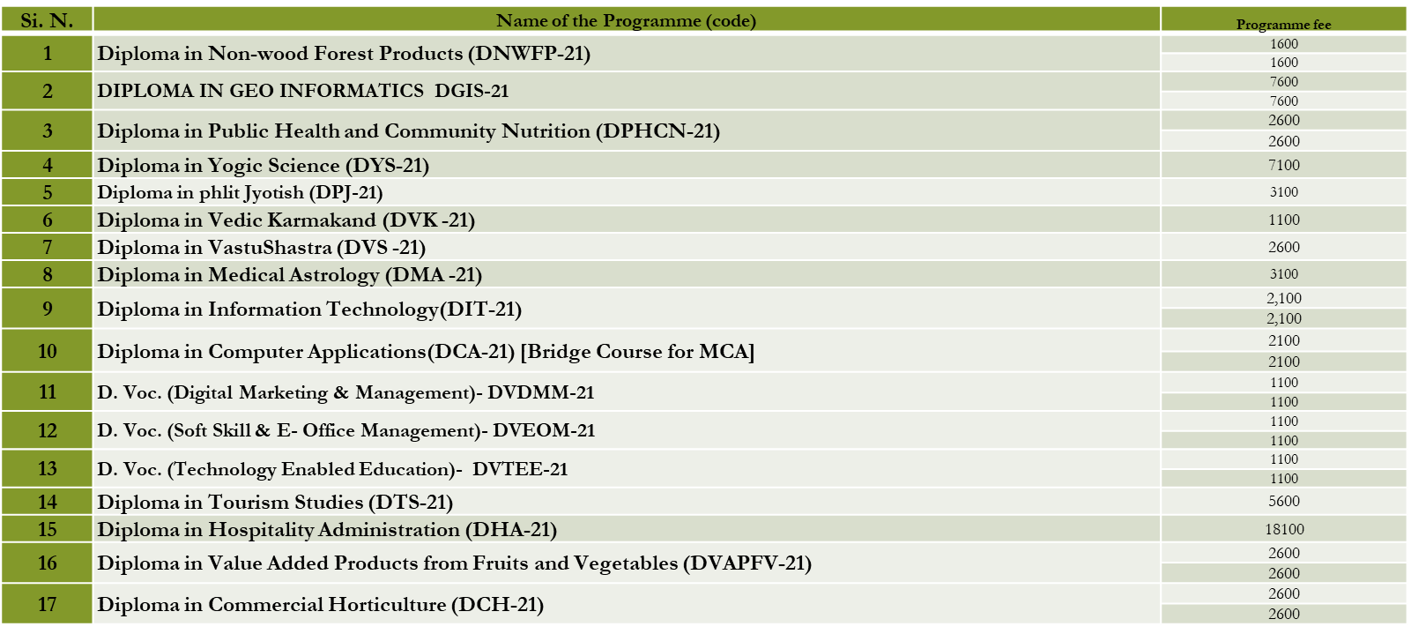
Fee Structure for the Different Courses Run by the University
Diploma Programmes

Slide 44
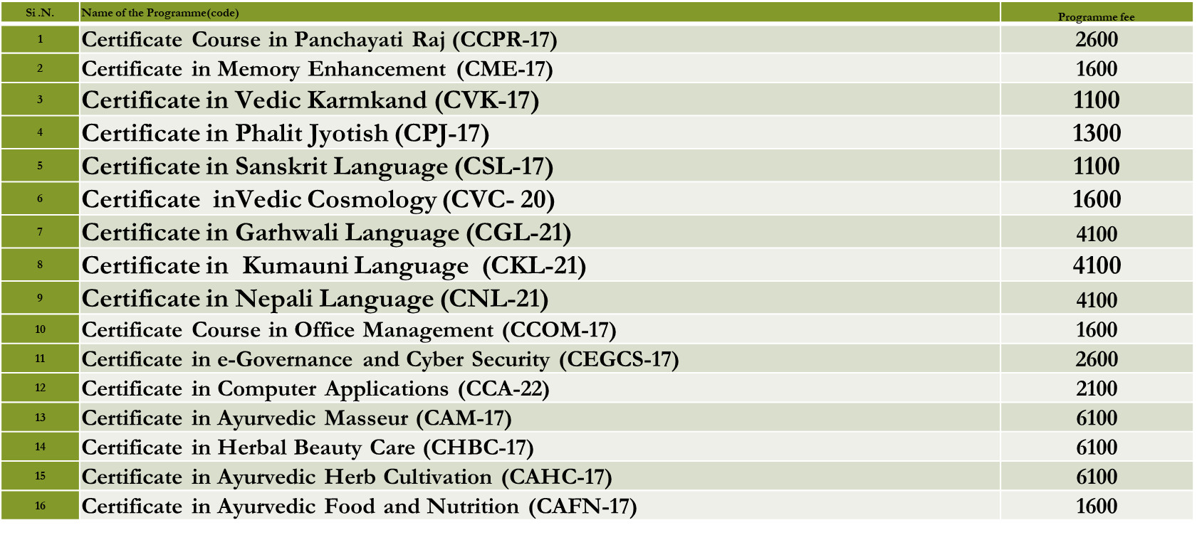
Fee Structure for the Different Courses Run by the University
Certificate Programmes

Slide 45
Examination System
Pre-Examination
Examination
Post-Examination

Slide 46
Pre-Examination
1 - Announcement
Inform Learner about examination by SMS, Email, Website and Social Media
3 - Examination Form
5 - Admit Card and Scribe Application & Exam Centre Change
2 - Exam Schedule
Pool of Experience Subject Experts Approved by the Council of Schools
4- Question Paper Setting
Candidates appearing in the examination can get the hall ticket from the University's website
Exams are taken at designated exam centers.
All eligible Back paper and Improvement learner can apply online for examination
6 - Exam Centre Finalization
Consent letter are taken from Exam Centers for taking exam according to UGC ODL Regulations from time to time
Publish Exam Schedule on Website
Learner with disability can apply for writer in prescribed application with required medical certificates
2 question papers are drawn per subject and one question paper is randomly selected

Slide 47
Assignment Related Activities
Assignment Question Paper Uploading
Publishing Assignment
Online Attempt of Assignment
Online Assignment Marks Import in SIS
Assignment Marks Available to Students

Slide 48
Exam Related Activities
Conduct Examination
Results / Marksheet Generation
Convocation
Academic Records Issue / RTI Answers
Issue of Duplicate Academic Records
Committee Meetings
Exam Centre Selection
Exam
Exam Disciplinary
Term End Exam
BA Yoga Entrance
Ph.D. Entrance
Ph.D. Course Work Exam
B.Ed. Entrance
Sp. B.Ed. Entrance

Slide 49
Question Paper Management System
Paper Setter Appointment
Receiving Question Paper and Acknowledge
Typing/Email
Moderation/Proof Reading
Selection of Question Paper
Question Paper Printing
Paper Send to Different Exam Centre

Slide 50
Question Paper Delivery System
Sealed Question Paper Received in University Strong Room
Centre Wise Segregation of Sealed Question Paper Packets
Distribution of sealed Question paper packets to each exam center
University
Examination Centre

Slide 51
Examination
Dispatch Exam Material
Examination
Distribution / Collection of -
Question Paper
Answer sheet
Hollow Sticker
Student verification /Attendance Sheet
Exam as per Schedule
Observer and Flying Squad
Answer sheet
Attendance Sheet
UFM Report, etc.

Slide 52
Assignment Related Activities
Collection of Answer sheet from exam center
Assessment/ Evaluation of Answer-sheet & Marks Received in OMR Award Sheet
Scanning of Marks from OMR Award sheet
Result Processing
Verification of Marks through TR and Announcement of Result
Scrutiny and Grievance
Bulk Marksheet Generation
Convocation

Slide 53
Number of Sanctioned Posts – Professors, Associate Professor, Assistant Professors
Name of Department/School | Subjects | Sanctioned | Filled
 |  | Professor/Associate Professor/ Assistant Professor | Professor/Associate Professor/ Assistant Professor
School of Agriculture & Development Studies | Agriculture | Professor- Professor (CAS)- Associate Professor-01 Assistant Professor-01 | Professor- Professor (CAS)- Associate Professor - Assistant Professor- 01
School of Vocational Studies | Vocational Studies | Professor- Professor (CAS)- Associate Professor- Assistant Professor- 01 | Professor- Professor (CAS)- Associate Professor- Assistant Professor-
School of Earth and Environmental Science | Geology Forestry Geography | Professor-01 Professor (CAS)- Associate Professor- Assistant Professor-02 | Professor-01 Professor (CAS)- Associate Professor- Assistant Professor-01
School of Tourism, Hospitality and Hotel Management | Hotel Management Tourism | Professor-01 Professor (CAS)- Associate Professor- Assistant Professor-02 | Professor- Professor (CAS)- Associate Professor- Assistant Professor-01
School of Education | Education Teacher Education B.Ed. Special Education | Professor-02 Professor (CAS)- Associate Professor-01 Assistant Professor-05 | Professor- Professor (CAS)- Associate Professor-01 Assistant Professor-05
School of Humanities | English Hindi Sanskrit Jyotish Urdu Music | Professor-01 Professor (CAS)- Associate Professor-01 Assistant Professor-07 | Professor- Professor (CAS)- Associate Professor- Assistant Professor-05

Slide 54
Number of Sanctioned Posts – Professors, Associate Professor, Assistant Professors
School of Management Studies & Commerce | Management Commerce | Professor-02 Professor (CAS)- Associate Professor-01 Assistant Professor-04 | Professor- Professor (CAS)- Associate Professor-01 Assistant Professor-03
School of Computer Sciences & Information Technology | Computer Science | Professor-01 Professor (CAS)- Associate Professor-01 Assistant Professor-01 | Professor-01 Professor (CAS)- Associate Professor-01 Assistant Professor-01
School of Social Science | History Sociology Political Science Psychology Economics Public Administration MSW | Professor-03 Professor (CAS)- Associate Professor-02 Assistant Professor-07 | Professor-02 Professor (CAS)- Associate Professor-01 Assistant Professor-05
School of Sciences | Physics Zoology Maths Chemistry Botany | Professor-01 Professor (CAS)- Associate Professor-02 Assistant Professor-08 | Professor- Professor (CAS)- Associate Professor-02 Assistant Professor-08
School of Health Sciences | Yoga Ayurveda Home Science | Professor- Professor (CAS)- Associate Professor- Assistant Professor-04 | Professor- Professor (CAS)- Associate Professor- Assistant Professor-03
School of Law | Law | Professor-01 Professor (CAS)- Associate Professor- Assistant Professor-01 | Professor- Professor (CAS)- Associate Professor- Assistant Professor-01
School of Journalism & Media Studies | Journalism-Advertisement and Public Relation | Professor-01 Professor (CAS)- Associate Professor-01 Assistant Professor-01 | Professor- Professor (CAS)- Associate Professor-01 Assistant Professor-01
School of Library & Information Sciences | Library Science | Professor- Professor (CAS)- Associate Professor- Assistant Professor-02 | Professor- Professor (CAS)- Associate Professor- Assistant Professor-

Slide 55
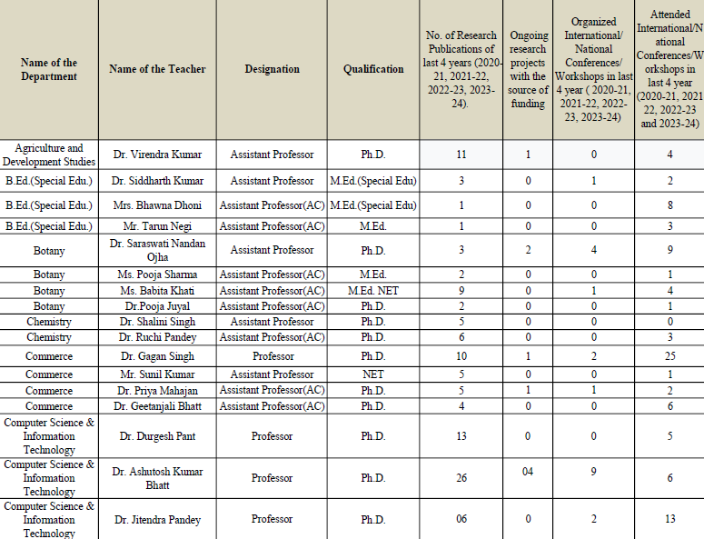
Names, Designations, Qualifications and Publications of the Existing Teaching Staff

Slide 56
Names, Designations, Qualifications and Publications of the Existing Teaching Staff

Slide 57
Names, Designations, Qualifications and Publications of the Existing Teaching Staff

Slide 58
Names, Designations, Qualifications and Publications of the Existing Teaching Staff

Slide 59
Names, Designations, Qualifications and Publications of the Existing Teaching Staff

Slide 60
Details of Non-Teaching Staff
S.N. | Name of the Department | Name of the Employee | Designation | Qualification
1 | Administrative | Shri Khemraj Bhatt | Registrar | PG
2 | Exam Department | Dr. Somesh Kumar | Exam Controller | Ph.D.
3 | Accounts | Shri Surya Pratap Singh | Finance Controller | PG
4 | Administrative | Mr. Vimal Kumar Mishra | Dy. Registrar | PG
5 | Registrar Office | Mr. Vikrant Kumar | Assistant Registrar | PG
6 | Accounts | Mr. Deepak Kumar | Assistant Registrar | UG
7 | Accounts | Mr. Mohan Chandra Pandey | Co-ordinator | UG
8 | Purchase & Store | Mr. Bupendra Nayal | Assistant Registrar | PG
9 | Exam Department | Mrs. Ratti Dogra | Assistant Registrar | UG
10 | Maintenance | Mr. Abhishek Kumar Vajpayee | Assistant Registrar | PG
11 | Establishment | Mr. Sanjay Bhatt | Personal Assistant/SO | UG
12 | Establishment | Mr. Rahul Bisht | Senior Assistant/SO | PG
13 | Accounts | Mr. Vimal Kumar | Stenographer/SO | PG
14 | Accounts | Mr. Ravindra Kumar Kohli | Senior Assistant/SO | UG
15 | Store | Mr. Parmendar Singh Parihar | Administrative Officer/SO | PG

Slide 61
Details of Non-Teaching Staff
16 | Maintenance | Mr. Bharat Nainwal | Senior Assistant/SO | PG
17 | Admission | Mr. Hem Chandra | Senior Assistant/SO | PG
18 | Admission | Smt. Kanchan Bisht | Administrative Consultant | MBA
19 | Exam Department | Mr. Vinay Kumar Tamta | Technical Consultant | MCA
20 | Exam Department | Smt. Kamla Rathore | Computer Literate Clerk | PG
21 | Exam Department | Mr. Nandan Singh Adhikari | Co-ordinator | PG
22 | Registrar Office | Mr. Nirmal Singh Dhauni | Co-ordinator | BCA
23 | Registrar Office | Smt. Deepa Fulara | Co-ordinator | PG
24 | Registrar Office | Mr. Raman Loshali | Computer Literate PA | PG
25 | Admission | Smt. Ranjana Joshi | Co-ordinator | PG
26 | Community Radio | Mr. Anil Nailwal | Technical Consultant (Radio) | PG
27 | Community Radio | Smt. Sunita Bhatt | Technical Consultant (Radio) | PG
28 | ICT Department | Mr. Mohit Rawat | Network Administrator | MCA
29 | ICT Department | Mr. Vineet Pauriyal | Hardware Engineer | B.Tech
30 | ICT Department | Mr. Rajendra Nath Goswami | Computer Programmer | MCA

Slide 62
Details of Non-Teaching Staff
31 | ICT Department | Mr. Jitendra Dwivedi | Computer Programmer | MCA
32 | ICT Department | Mr. Rajesh Arya | Hardware Engineer | BIT
33 | Regional Services | Mr. Brijesh Kumar Bankoti | Assistant Regional Director/DR | PG
34 | Regional Services | Mr. Pankaj Kumar | Assistant Regional Director/DR | MCA
35 | Regional Services | Mrs. Rekha Bisht | Assistant Regional Director/DR | MBA
36 | Regional Services | Mrs. Priyanka Lohani | Assistant Regional Director/DR | MBA
37 | Regional Services | Mr. Anil Kandari | Assistant Regional Director/DR | PG
38 | Regional Services | Mr. Bhasker Chandra Joshi | Assistant Regional Director/DR | PG
39 | Regional Services | Mr. Govind Singh | Assistant Regional Director/DR | PG
40 | Regional Services | Mrs. Ruchi Arya | Assistant Regional Director/DR | PG
41 | Regional Services | Mr. Firoj Khan | Senior Assistant | PG
42 | Regional Services | Mr. Harsh Vardhan Lohani | Computer Literate Accountant | PG
43 | Registrar Office | Mr. Trilochan Patni | Senior Assistant/SO | PG
44 | Registrar Office | Mr. Mahboob Alam | Senior Assistant | UG
45 | Registrar Office | Mr. Brij Mohan Khati | Senior Assistant/SO | PG

Slide 63
Details of Non-Teaching Staff
46 | Registrar Office | Mr. Narendra Jaguri | Administrative Consultant | LLM
47 | Registrar Office | Mr. Manoj Kumar Sharma | Computer Literate Clerk | PG
48 | Maintenance | Mr. Shekhar Chandra | Driver | Under High School
49 | Maintenance | Mr. Mohan Chandra Pandey | Driver | Intermediate
50 | Maintenance | Mr. Devendra Singh | Driver | Under High School
51 | MPDD | Mr. Yogesh Mishra | Computer Literate Clerk | UG
52 | MPDD | Mr. Pankaj Bisht | Computer Literate Clerk | UG
53 | Camp Office | Mr. Ajay Kumar Singh | Co-ordinator | UG
54 | Research & Innovation | Smt. Sarojini | Research Officer/AR | PG
55 | Research & Innovation | Smt. Karishma | Research Officer | NET
56 | Research & Innovation | Mr. Trilok Singh | Research Officer/AR | PG
57 | ICT Department | Mr. Anurag Bhatt | Assistant Director Computer IT/AR | M.Tech.
58 | ICT Department | Mr. Gurudev Singh Rana | Assistant Director Computer IT/AR | MCA
59 | ICT Department | Mr. Navneet Kumar | Assistant Director Computer IT/AR | M.Sc.
60 | ICT Department | Mr. Pawan Kumar | Assistant Director Computer IT/AR | M.Tech.

Slide 64
Details of Non-Teaching Staff
61 | ICT Department | Mr. Girija Shankar Joshi | System Manager | MCA
62 | Media | Dr. Rakesh Rayal | Public Relation Officer | MJMC
63 | Research & Innovation | Mr. Rajendra Joshi | Administrative Consultant | PG
64 | Model Study Centre | Mr. Yogesh Chandra Gururani | Administrative Consultant | UG
65 | MPDD | Mr. Vinod Kumar Birkhani | Administrative Consultant | PG
66 | Video Lab | Mr. Harish Kumar Goyal | Video Editor | PG
67 | Video Lab | Mr. Vibhu Kandpal | Cameraman | PG
68 | Printing | Smt. Babita Das | Computer Literate Steno | PG
69 | ICT Department | Mr. Rakesh Papnai | Website Administrator | UG
70 | Regional Services | Mr. Santosh Dhaundiyal | Computer Literate Clerk | PG
71 | Registrar Office | Mr. Basant Ballabh Kandpal | Computer Literate Clerk | PG
72 | Director Academics | Mr. Charu Chandra Joshi | Computer Literate Clerk | PG
73 | Dispatch | Mr. Gopal Singh | Computer Literate Clerk | UG
74 | Camp Office | Mr. Kundan Singh | Clerk | Intermediate
75 | Exam Department | Smt. Madhu Dogra | Data Entry Operator | PG

Slide 65
Details of Non-Teaching Staff
76 | Admission | Mr. Anil Pant | Data Entry Operator | PG
77 | Library | Dr. Meetu Gupta | Cataloguer | Ph.D.
78 | RTI | Mr. Man Mohan Tripathi | Clerk | LLB
79 | Maintenance | Mr. Dinesh Pal Singh | Electrician | Intermediate
80 | Maintenance | Mr. Manish Singh | Driver | Intermediate
81 | Journalism Department | Smt. Poonam Kholia | Computer Operator | UG
82 | Exam Department | Mr. Manish Bungla | Lab Assistant | Intermediate
83 | Maintenance | Mr. Devendra Prasad | Plamber | Intermediate
84 | VC Office | Mr. Hem Chnandra | Computer Operator | PG
85 | Maintenance | Mr. Vyas Singh | Peon | 8th
86 | Maintenance | Mr. Chet Bahadur Thapa | Peon | Intermediate
87 | Dispatch | Smt. Neema Upreti | Co-ordinator | PG
88 | MPDD | Mr. Naveen Chandra Joshi | Peon | 8th
89 | MPDD | Mr. Kailash Ram Vishvakarma | Peon | Intermediate
90 | MPDD | Mr. Deepak Chandra Upreti | Book Lifter | 8th

Slide 66
Details of Non-Teaching Staff
91 | MPDD | Mr. Rajendra Prasad Sharma | Helper | Intermediate
92 | Maintenance | Mr. Manoj Kumar | Gardner | Intermediate
93 | Registrar Office | Mr. Balwant Ram | Co-ordinator | PG
94 | Maintenance | Mr. Dileep | Sweeper | 8th
95 | Exam Department | Mr. Mohan Chandra | Clerk | UG
96 | Registrar Office | Mr. Satyendra Singh | Clerk | PG
97 | Accounts | Mr. Dinesh Kumar | Clerk | Intermediate
98 | Director Academics | Mr. Dinesh Chandra Fulera | Peon | Intermediate
99 | Exam Department | Mr. Jagat Singh Bangari | Peon | Intermediate
100 | Maintenance | Smt. Chaya Devi | Sweeper | 5th

Slide 67
Details of Salary Structure for Teaching Staff
Teaching Position | Salary Structure
Professor | As per UGC and State Government Norms
Associate Professor | As per UGC and State Government Norms
Assistant Professor | As per UGC and State Government Norms
Assistant Professor (Contractual) | Rs. 35,000/-(Fix Per Month)

Slide 68
Proposals Under Institutional Development Planning
Five-Year Plan for the Establishment of the Center for Vocational Education and Skill Development.
Proposal for NCVET Recognition.
Establishment of IT Academy for Open and Distance Learning in Uttarakhand.
Proposal for Centre of Excellence in Online and Digital Learning by Uttarakhand Open University, Haldwani.
Establishment of Campus at Dehradun to Facilitate the Learners.
Awareness and Sensitization of Key Functionaries of Uttarakhand Government, Local Bodies for The Empowerment and Other Services of Persons with Disabilities.

Slide 69
Thank You

